Slide 1
Movie Recommendation Flixify
New User
Existing User
Let’s begin the show

Slide 2
CONTENTS
01
02
03
NECESSITY
ABOUT DATA
METHODOLOGIES
04
05
06
ENVIRONMENT
APP FLOW
CHALLENGES
01
02
03
Why do we need recommendation systems
Insights and Visualizations
Filtering and machine learning techniques
04
05
06
API, database and web application deployment
Application walk-through
Challenges encountered and future scope

Slide 3
Why Recommendation?
01
Huge Content
02
Personalized Recommendation
03
New Content
04
User Experience
01
02
Overwhelming content that’s growing every day
We enjoy personalized recommendations
03
04
A lot of content that might not be discovered
Enhances user experience on platforms

Slide 4
01
ABOUT DATA
02
Insights and Visualizations

Slide 5
ABOUT DATA
01
Movies
02
Ratings
03
Tags
04
Links
01
02
Movie information with Movie ID, Title, Genre
Rating info with User ID, Movie ID, Rating
03
04
Short one line or one word review with Movie ID
Movie IDs to fetch additional info from TMBD, IMDB

Slide 6
ABOUT DATA

Slide 7
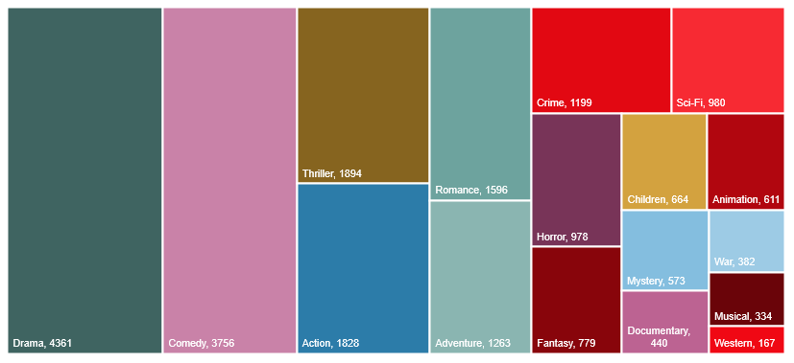
ABOUT DATA

Slide 8
ABOUT DATA

Slide 9
ABOUT DATA

Slide 10
01
METHODOLOGIES
03
Movie Recommendation Techniques

Slide 11
Recommendation Techniques
Filtering
Content Based Filter
01
03
Get recommendations by rating and genre
Get recommendation by similar movie
Collaborative Filter SVD
Collaborative Filtering NN
02
04
Get recommendations from similar user’s using singular value decomposition
Get recommendations from similar users using neural networks

Slide 12
Filtering and Similarity
Filtering
Similarity
Fetch movie recommendations based on rating and genre.
Uses SQL queries to fetch recommendations.
Get movie name from user and recommend similar movies.
Using technique called as cosine similarity

Slide 13

Collaborative Filtering
A machine learning technique used to make personalized recommendation based on user preferences.
Recommend movies to a user based on the preferences of other users who have similar taste in movies.

Slide 14
01
ENVIRONMENT
04
Web application deployment environment

Slide 15

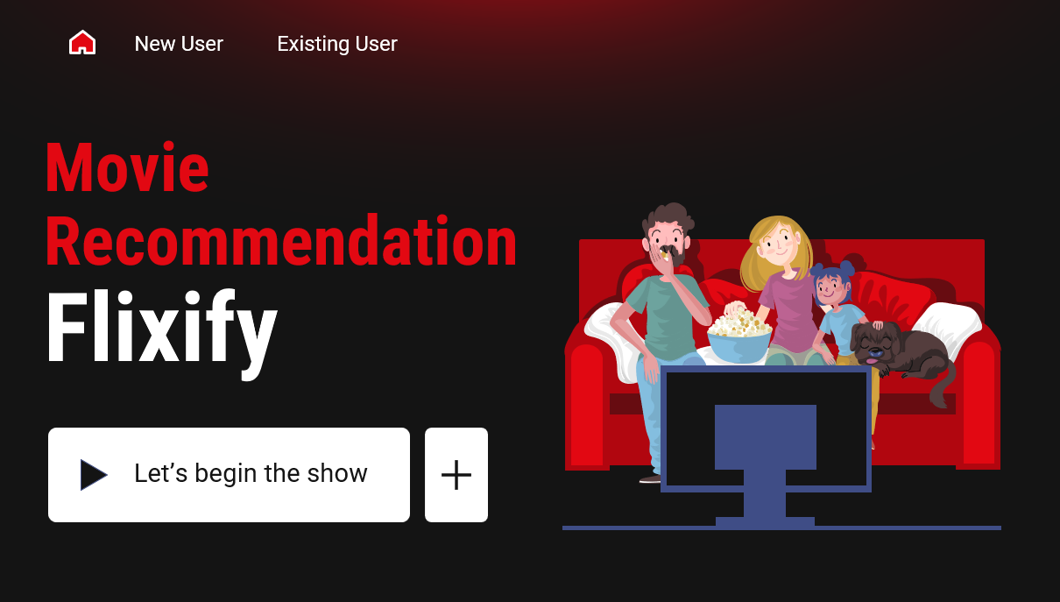


APPLICATION ENVIRONMENT
DATABASE
REST API
WEB APPLICATION
Postgres DB in AWS RDS
Flask application deployed in heroku
Angular application deployed using Gooogle Firebase

Slide 16
01
APPLICATION FLOW
05
Walk-Through.

Slide 17
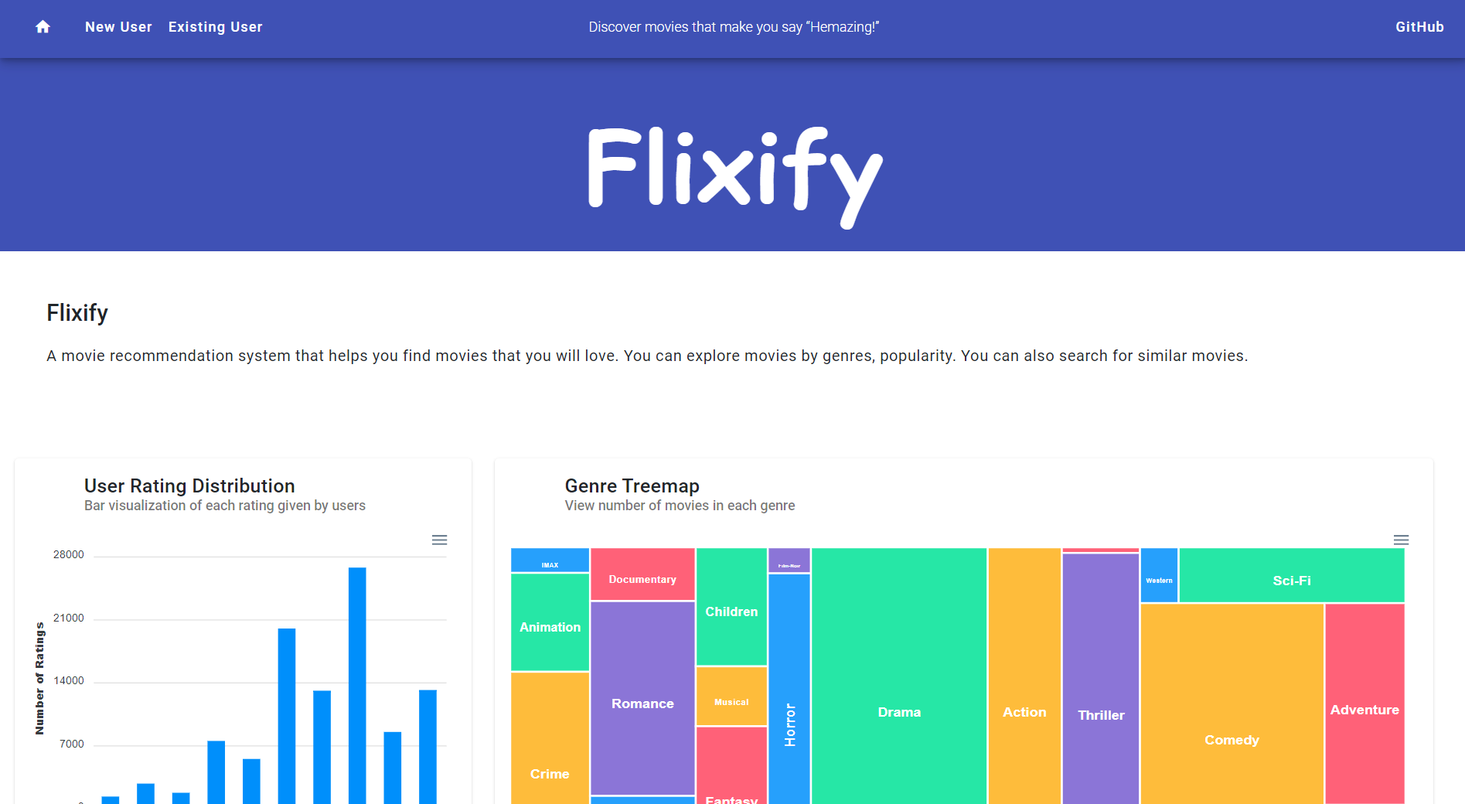
APPLICATION FLOW - DASHBOARD
Visualizations of the data displayed which convey information about dataset and data we are dealing.

Slide 18
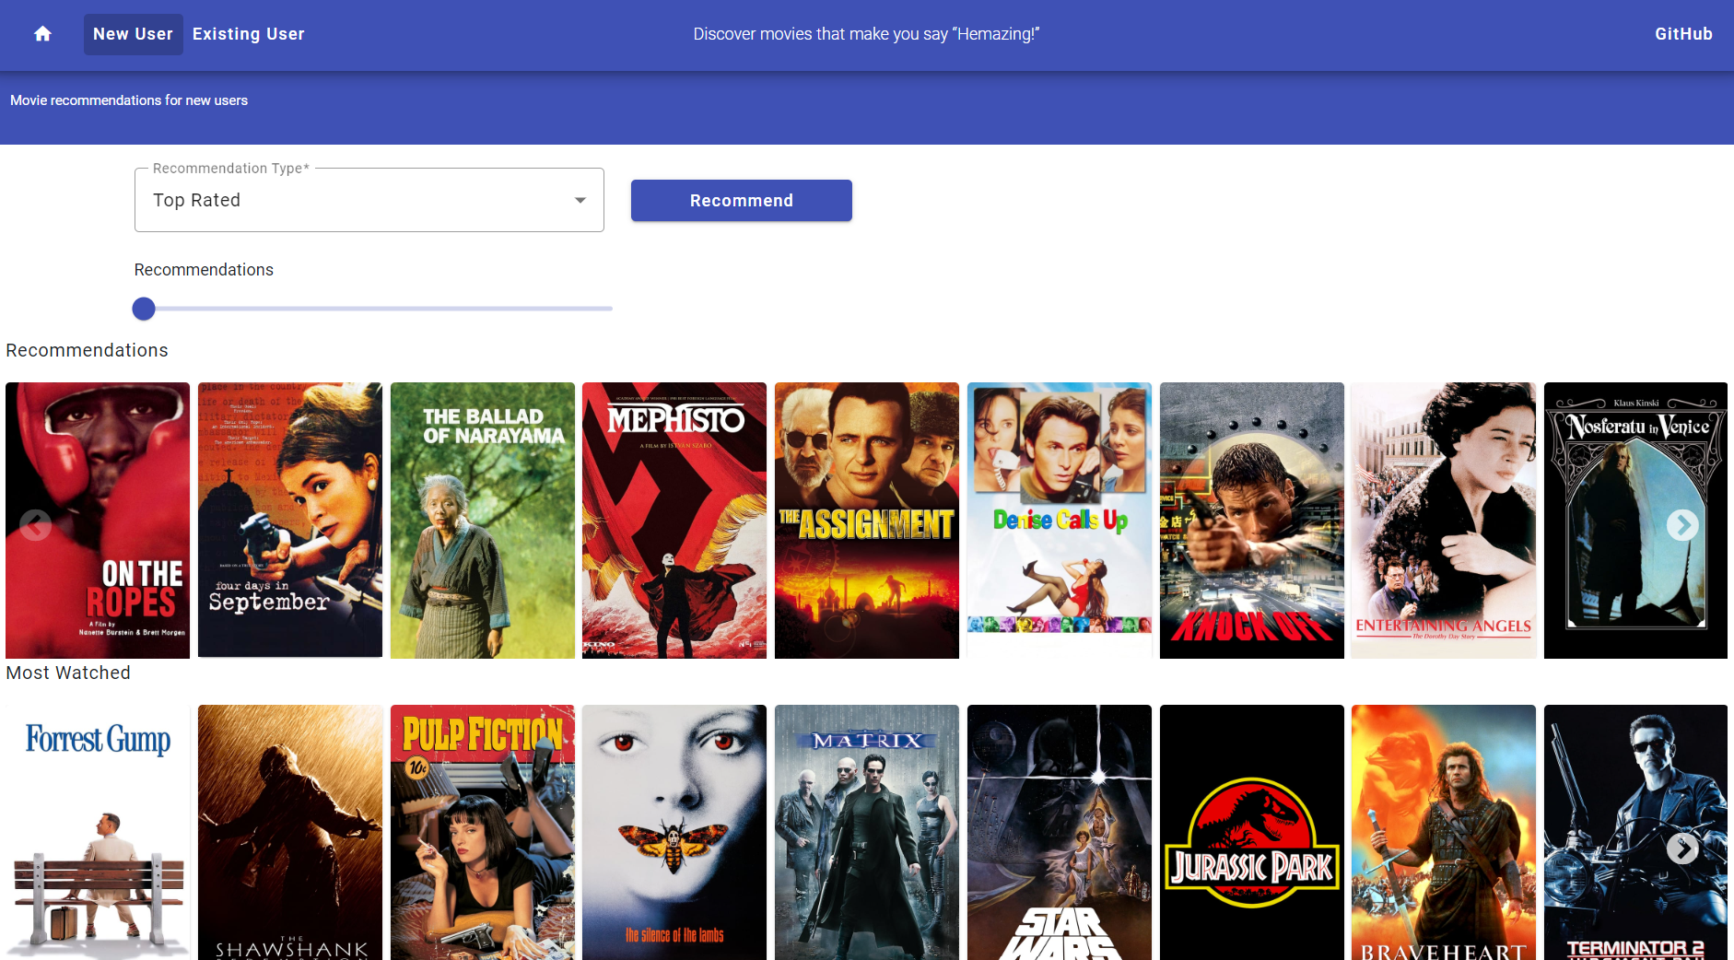
APPLICATION FLOW – New User
TOP RATED
TOP RATED BY GENRE
SIMILAR MOVIE
Gets top rated movies from all the genres
Gets top rated movies by genre
Ask for a movie and recommend similar movie

Slide 19
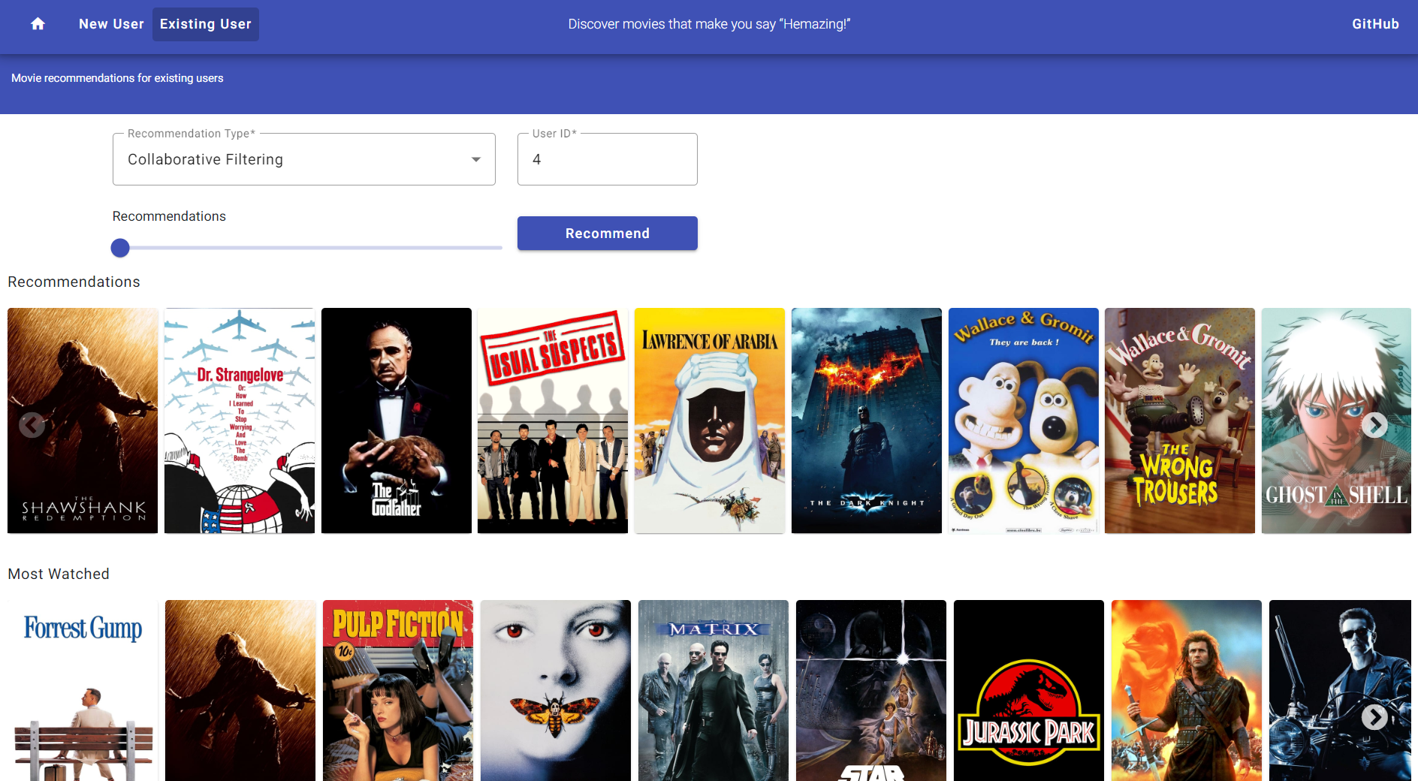
APPLICATION FLOW – Existing User
COLAB FILTER SVD
COLAB FILTER NN
SIMILAR MOVIE
Gets recommendations using SVD Algorithm
Gets recommendation using Neural network
Ask for a movie and recommend similar movie

Slide 20
01
CHALLENGES
06
Problems encountered and future scope

Slide 21
CHALLENGES – Cold Start
A difficulty in making accurate predictions for new users who limited historical data.
Active learning can be used to tackle this problem.
Used similar movie recommendation for new users which is a content-based filtering technique.

Slide 22
CHALLENGES – Other
FLASK APP HTTPS
SLUG FILE LIMIT
Application didn’t accept
response from flask
application deployed in AWS
with http.
WORKAROUND:
Moved to Heroku.
Heroku has a deployment
package limit of 500 MB but
my package was around 2.4
GB.
WORKAROUND:
Changed the PyTorch dependency to CPU only dependency.

Slide 23
FUTURE SCOPE – Address Cold Start
Implement Active Learning:
Ask new users to provide feedback on a subset of data and recommend movies based on user’s feedback

Slide 24
THANK YOU

